Slide 1
Chapter 6
Registering and Discovering
Web services
Mike P. Papazoglou
mikep@uvt.nl

Slide 2
Topics
Service registries and discovery
Universal Description, Discovery and Integration

Slide 3
SOA interactions between actors
Service
Service
(2) Query for all
Service
(2) Query for all
Problem to solve:
  How to find the service a client wants among a large collection of services and providers.
  The client does not necessarily need to know which provider provides the service.
(2) Query for all
(3) Discovery
(3) Discovery
(3) Discovery
registry
Registry
matching services in
Registry
matching services in
the
results
results
registry
results
registry
registry
(1) Registration
(1) Registration
(1) Registration
request for
request for
request for
service description
service description
service description
(4) Request
(4) Request
(4) Request
for selected
for selected
for selected
(5) Service
(5) Service
service information
(5) Service
service information
service information
information of
information of
information of
PUBLISH
selected service
PUBLISH
selected service
selected service
(6) Invocation request
(6) Invocation request
SEARCH
(6) Invocation request
SEARCH
including possible inputs
including possible inputs
including possible inputs
Service
provider
E
E
-
-
service
INVOKE
service
INVOKE
Service provider
Service provider
provider
provider
Service
requestor
(7) Invocation results
Service requester
(7) Invocation results
Service requester

Slide 4
Service registries
To discover Web services, a service registry is needed. This requires describing and registering the Web service.
Publication of a service requires proper description of a Web service in terms of business, service, and technical information.
Registration deals with persistently storing the Web service descriptions in the Web services registry.
Two types of registries can be used:
  The document-based registry: enables its clients to publish information, by storing XML-based service documents such as business profiles or technical specifications (including WSDL descriptions of the service).
  The meta-data-based service registry: captures the essence of the submitted document.

Slide 5
Service discovery
Service discovery is the process of locating Web service providers, and retrieving Web services descriptions that have been previously published.
Interrogating services involve querying the service registry for Web services matching the needs of a service requestor.
  A query consists of search criteria such as:
    the type of the desired service, preferred price and maximum number of returned results, and is executed against service information published by service provider.
  Discovering Web services is a process that is also dependent on the architecture of the service registry.
After the discovery process is complete, the service developer or client application should know the exact location of a Web service (URI), its capabilities, and how to interface with it.

Slide 6
Types of service discovery
Static
The service implementation details are bound at design time and a service retrieval is performed on a service registry.
The results of the retrieval operation are examined usually by a human designer and the service description returned by the retrieval operation is incorporated into the application logic.
Dynamic
The service implementation details are left unbound at design time so that they can be determined at run-time.
The Web service requestor has to specify preferences to enable the application to infer/reason which Web service(s) the requester is most likely to want to invoke.
Based on application logic quality of service considerations such as best price, performance, security certificates, and so on, the application chooses the most appropriate service, binds to it, and invokes it.

Slide 7
Topics
Service registries and discovery
Universal Description, Discovery and Integration

Slide 8
What is UDDI?
The universal description, discovery, and integration is a registry standard for Web service description and discovery together with a registry facility that supports the WS publishing and discovery processes.
UDDI enables a business to:
  describe its business and its services;
  discover other businesses that offer desired services;
  integrate (interoperate) with these other businesses.
Conceptually, a UDDI business registration consists of three inter-related components:
  “white pages” (address, contact, and other key points of contact);
  “yellow pages” classification info. based on standard industry taxonomies; and
  “green pages”, the technical capabilities and information about services.

Slide 9
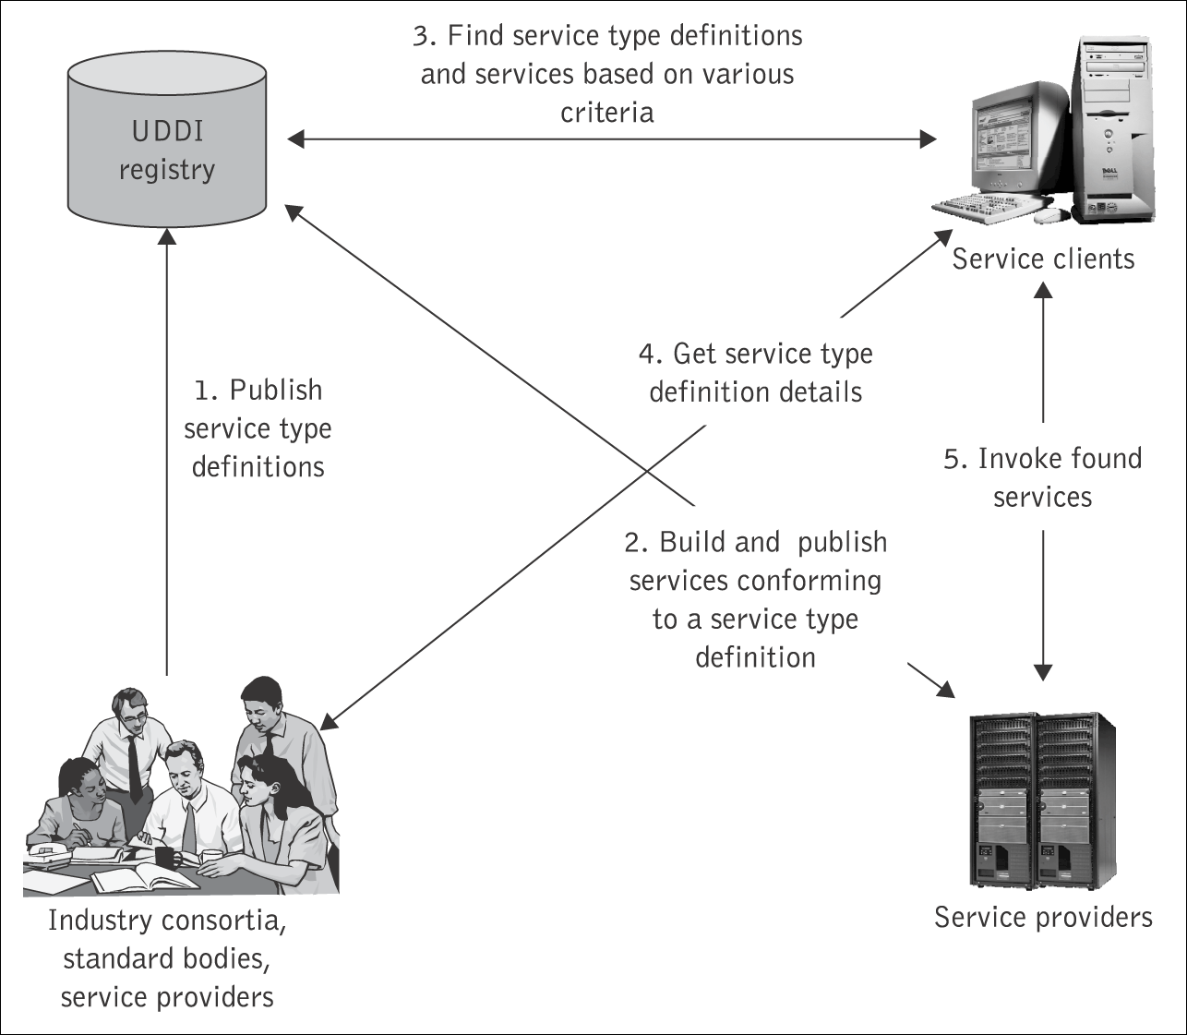
The UDDI usage model
An enterprise may set up multiple private UDDI registries in-house to support intranet and e-Business operations.
Public UDDI registries can be set up by customers and business partners of an enterprise.
  Services must be published in a public UDDI registry so that potential clients and service developers can discover them.

Slide 10
UDDI – main characteristics
UDDI provides a mechanism to categorize businesses and services using taxonomies.
  Service providers can use a taxonomy to indicate that a service implements a specific domain standard, or that it provides services to a specific geographic area
  UDDI uses standard taxonomies so that information can be discovered on the basis of categorization.
UDDI business registration: an XML document used to describe a business entity and its Web services.
UDDI is not bound to any technology. In other words,
  An entry in the UDDI registry can contain any type of resource, independently of whether the resource is XML based or not, e.g., the UDDI registry could contain information about an enterprise’s electronic document interchange (EDI) system or even a service that, uses the fax machine as its primary communication channel.
  While UDDI itself uses XML to represent the data it stores, it allows for other kinds of technology to be registered.

Slide 11
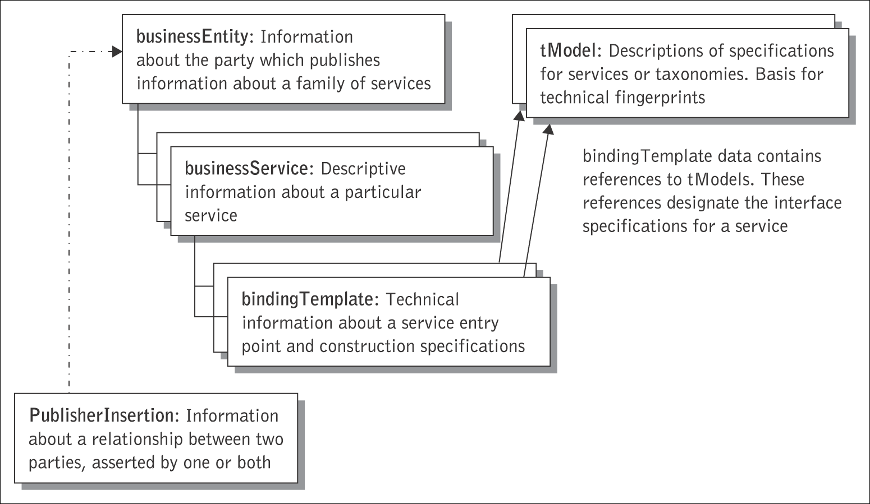
UDDI – Data Structures
UDDI also defines a data structure standard for representing company and service description information. The UDDI XML schema defines four core types of information.These are
  businessEntity: a description of the organization that provides the service.
  businessService: a list of all the Web services offered by the business entity.
  bindingTemplate: describes the technical aspects of the service being offered.
  tModel: (“technical model”)is a generic element that can be used to store technical information on how to use the service, conditions for use, guarantees, etc.

Slide 12
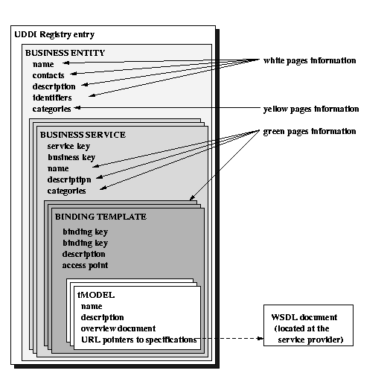
UDDI – Data Structures

Slide 13
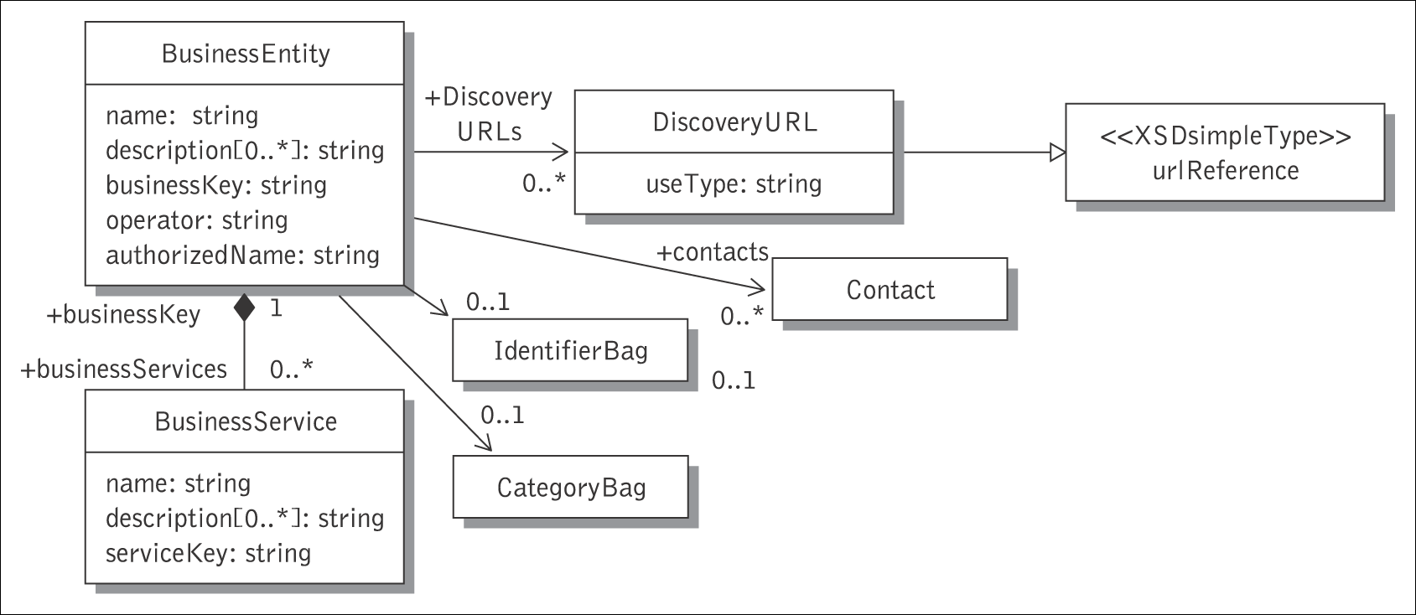
Business entity
The generic white and yellow pages information about a service provider is stored in the businessEntity data structure.

Slide 14
Example – Business entity
<businessEntity businessKey="d2300-3aff-.."
xmlns = “urn:uddi-org:api_v2”>
<name xml: lang="en"> Automotive Equipment Manufacturing Inc. </name>
<description xml: lang="en">
Automotive Equipment, Accessories and Supplies for European firms
</description>
<contacts>
<contact useType="Sales Contact">
<description xml: lang="en"> Sales Representative </ description>
<personName> Reginald Murphy </personName>
<email useType="primary"> joe.murphy@automeq.com </email>
<address useType="http">
<addressLine> http://www.medeq.com/sales/ </addressLine>
</address>
</contact>
</contacts>
<businessServices>
<!-- Business service information goes here -->
</businessServices>
<identifierBag>
<!-- DUNS Number identifier System -->
<keyedReference keyName="DUNS Number" keyValue="…" tModelKey="…"/>
</identifierBag>
<categoryBag>
<!—North American Industry Classification System (NAICS) -->
<keyedReference
keyName="Automotive parts distribution" keyValue="…" tModelKey="…"/>
……
</categoryBag>
</businessEntity>
Notes:
Here we have an example using the business entity data structure.
businessKey – unique identifier for a given instance of the businessEntity structure
authorizedName – recorded name of the individual that published the businessEntity data. This is generated by the controlling operator, and should not be supplied with save_business operations.
operator – certified name of the UDDI registry site operator that manages the master copy of the businessEntity data. The controlling operator records this data at the time the data is saved. This is generated and should not be supplied within save_business operations.
This is obviously just a quick example. There are many optional elements with the data structures, and we have only shown part of the potential businessEntity data structure here.

Slide 15
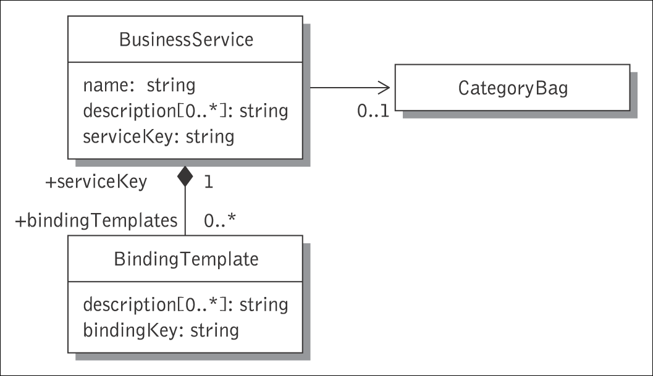
Business service
The services provided by a business entity are described in business terms using businessService elements.
A businessEntity can have several businessServices but a businessService belongs to one businessEntity.
A businessService contains:
  a serviceKey that uniquely identifies the service and the businessEntity
  (not necessarily the same as where
  the businessService is found),
  name: as before,
  description: as before,
  categoryBag: as before,
  bindingTemplates: a list to all the bindingTemplates for the service with the technical information on how to access and use the service.

Slide 16
Example – Business service
<businessServices>
<businessService serviceKey=" ">
<name> Search the Automotive Equipment Manufacturing parts Registry </name>
<description lang="en">
Get to the Automotive Equipment Manufacturing parts Registry
</description>
<bindingTemplates>
<bindingTemplate bindingKey="..">
<description lang="en">
Use your Web Browser to search the parts registry
</description>
<accessPoint URLType="http">
http://www.automeq.com/b2b/actions/search.jsp
</accessPoint>
<tModelInstanceDetails>
<tModelInstanceInfo
tModelKey=”uddi:..”/>
<tModelInstanceDetails>
</bindingTemplate>
</bindingTemplates>
</businessService>
</businessServices>
Notes:
Here we have an example using the business entity data structure.
businessKey – unique identifier for a given instance of the businessEntity structure
authorizedName – recorded name of the individual that published the businessEntity data. This is generated by the controlling operator, and should not be supplied with save_business operations.
operator – certified name of the UDDI registry site operator that manages the master copy of the businessEntity data. The controlling operator records this data at the time the data is saved. This is generated and should not be supplied within save_business operations.
This is obviously just a quick example. There are many optional elements with the data structures, and we have only shown part of the potential businessEntity data structure here.

Slide 17
Binding template: “green pages”
A binding template contains the technical information associated to a particular service:
  bindingKey
  serviceKey
  description
  accessPoint: the network address of the service being provided
  tModels: a list of entries corresponding to tModels associated with this particular binding
  categoryBag: additional information about the service and its binding (e.g., whether it is a test binding, it is on production, etc).
A businessService can have several bindingTemplates but a binding Template has only one businessService.
The binding template is seen as a folder, where all the technical information of a service is put together.
<bindingTemplate bindingKey="..">
<description lang="en">
Use your Web Browser to search the parts registry
</description>
<accessPoint URLType="http">
http://www.automeq.com/b2b/actions/search.jsp
</accessPoint>
<tModelInstanceDetails>
<tModelInstanceInfo
tModelKey=”uddi:..”/>
<tModelInstanceDetails>
</bindingTemplate>

Slide 18
tModel
URL pointing to a zipped file where a description of the PIP 3A1 "Request Quote" can be found
A tModel is a generic container of information which contains technical information associated with the use of a Web service:
  the actual interface and protocol used, including a pointer to the WSDL description;
  description of the business protocol and conversations supported by the service.
A tModel can point to other tModels and eventually different forms of standardized tModels:
  tModel for WSDL services, tModels for EDI-based services, RosettaNet Partner Interface Processes (PIPs) …
<tModel tModelKey="…" >
<name> RosettaNet-Org </name>
<description xml:lang=”en”>
Supports a process for trading partners to request and provide quotes
</description >
<overviewDoc>
<description xml:lang=”en”>
This compressed file contains the specification in a word
document, the html guidelines document, and the XML schemas.
</ description>
<overviewURL>
http://www.rosettanet.org/rosettanet/Doc/0/
K96RPDQA97A1311M0304UQ4J39/3A1_RequestQuote.zip
</overviewURL>
</overviewDoc>
<categoryBag>
<keyedReference keyName=" Trading quote request and provision"
keyValue=" 80101704" tModelKey=" ….."/>
</categoryBag>
</tModel>
List of name–value pairs that are used to record specific taxonomy information, e.g., industry, product or geographic codes, for this <tModel>

Slide 19
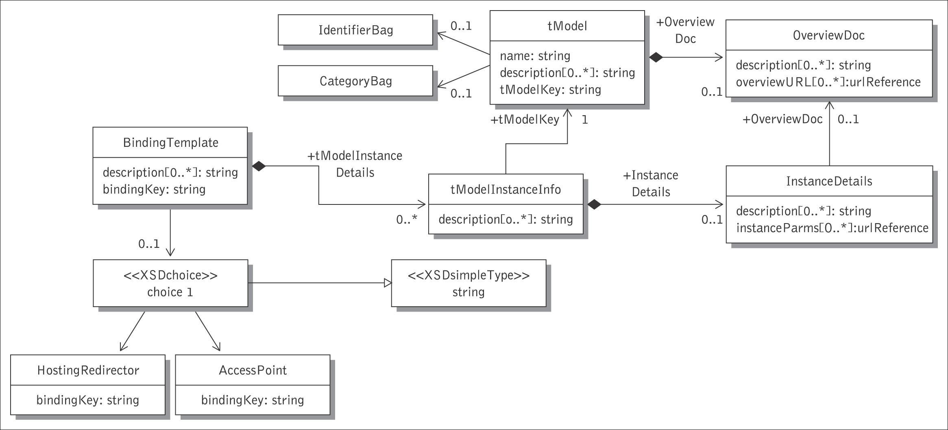
<bindingTemplate> and <tModel> in UML

Slide 20
UDDI and WSDL
UDDI entry
White pages info.
Yellow pages info.
UDDI
service
registry
Green pages info.
Technical info.
Pointer to service description
Service
description
Inquiry URL
Publishing URL
SOAP-HTTP
SOAP-HTTPS
Service
provider
Service
requestor
WSDL
service
description

Slide 21
WSDL to UDDI Mapping Model
The service description in WSDL documents is complementary to the information found in UDDI business and service entries. These two constructs are quite complementarily work together naturally.
  UDDI and WSDL distinguish clearly between interface and implementation.
  By decoupling a WSDL specification and registering it in UDDI, we can populate UDDI with standard interfaces that have multiple implementations, providing a landscape of business applications that share interfaces.

Slide 22
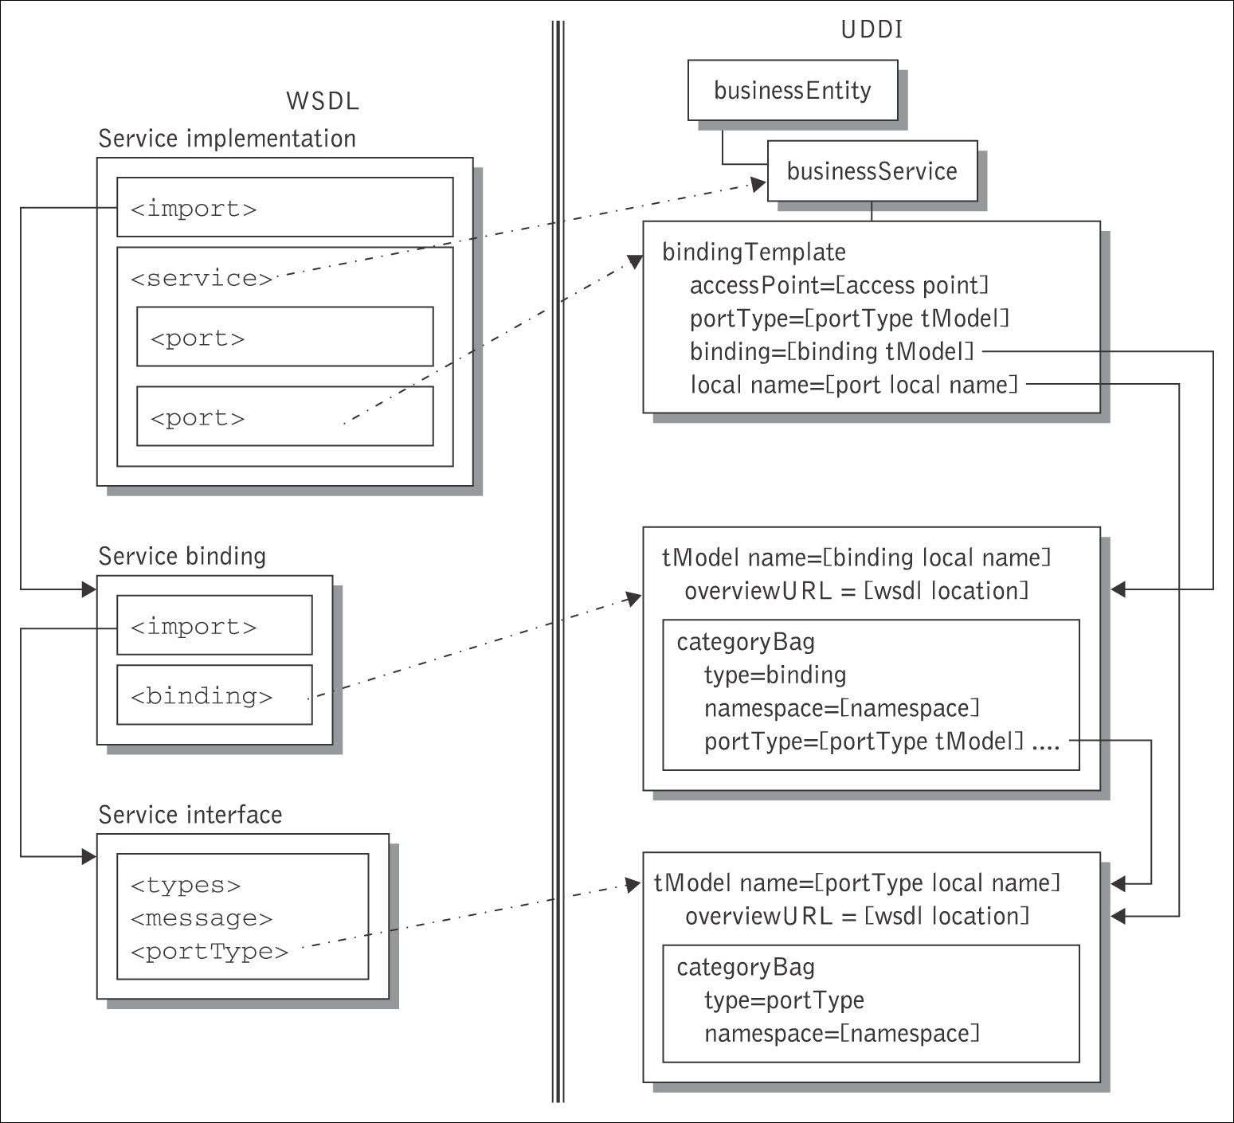
Mapping WSDL to UDDI schemas

Slide 23
Example of UDDI <tModel> created from WSDL
<portType> element
<tModel tModelKey="uuid:e8cf1163…" >
<name>
PurchaseOrderPortType
</name>
<overviewDoc>
<overviewURL>
http://supply.com:8080/PurchaseOrderService.wsdl
<overviewURL>
<overviewDoc>
<categoryBag>
<keyedReference
tModelKey="uuid:d01987d1…"
keyName="portType namespace"
keyValue="http://supply.com/PurchaseService/wsdl" />
<keyedReference
tModelKey="uuid:6e090afa…"
keyName="WSDL type"
keyValue="portType" />
</categoryBag>
</tModel>
The <tModel> name is the same as the WSDL name of the <portType>.
Information in the <portType> about
messages, operations, etc. is not
duplicated in UDDI so the <portType
tModel> must refer to the WSDL
document in which the <portType> is
defined.
Development tools that generate a
programming language interface from
the <portType>, or
validate requests against the definition of
the <portType>, can retrieve the
associated WSDL document.

Slide 24
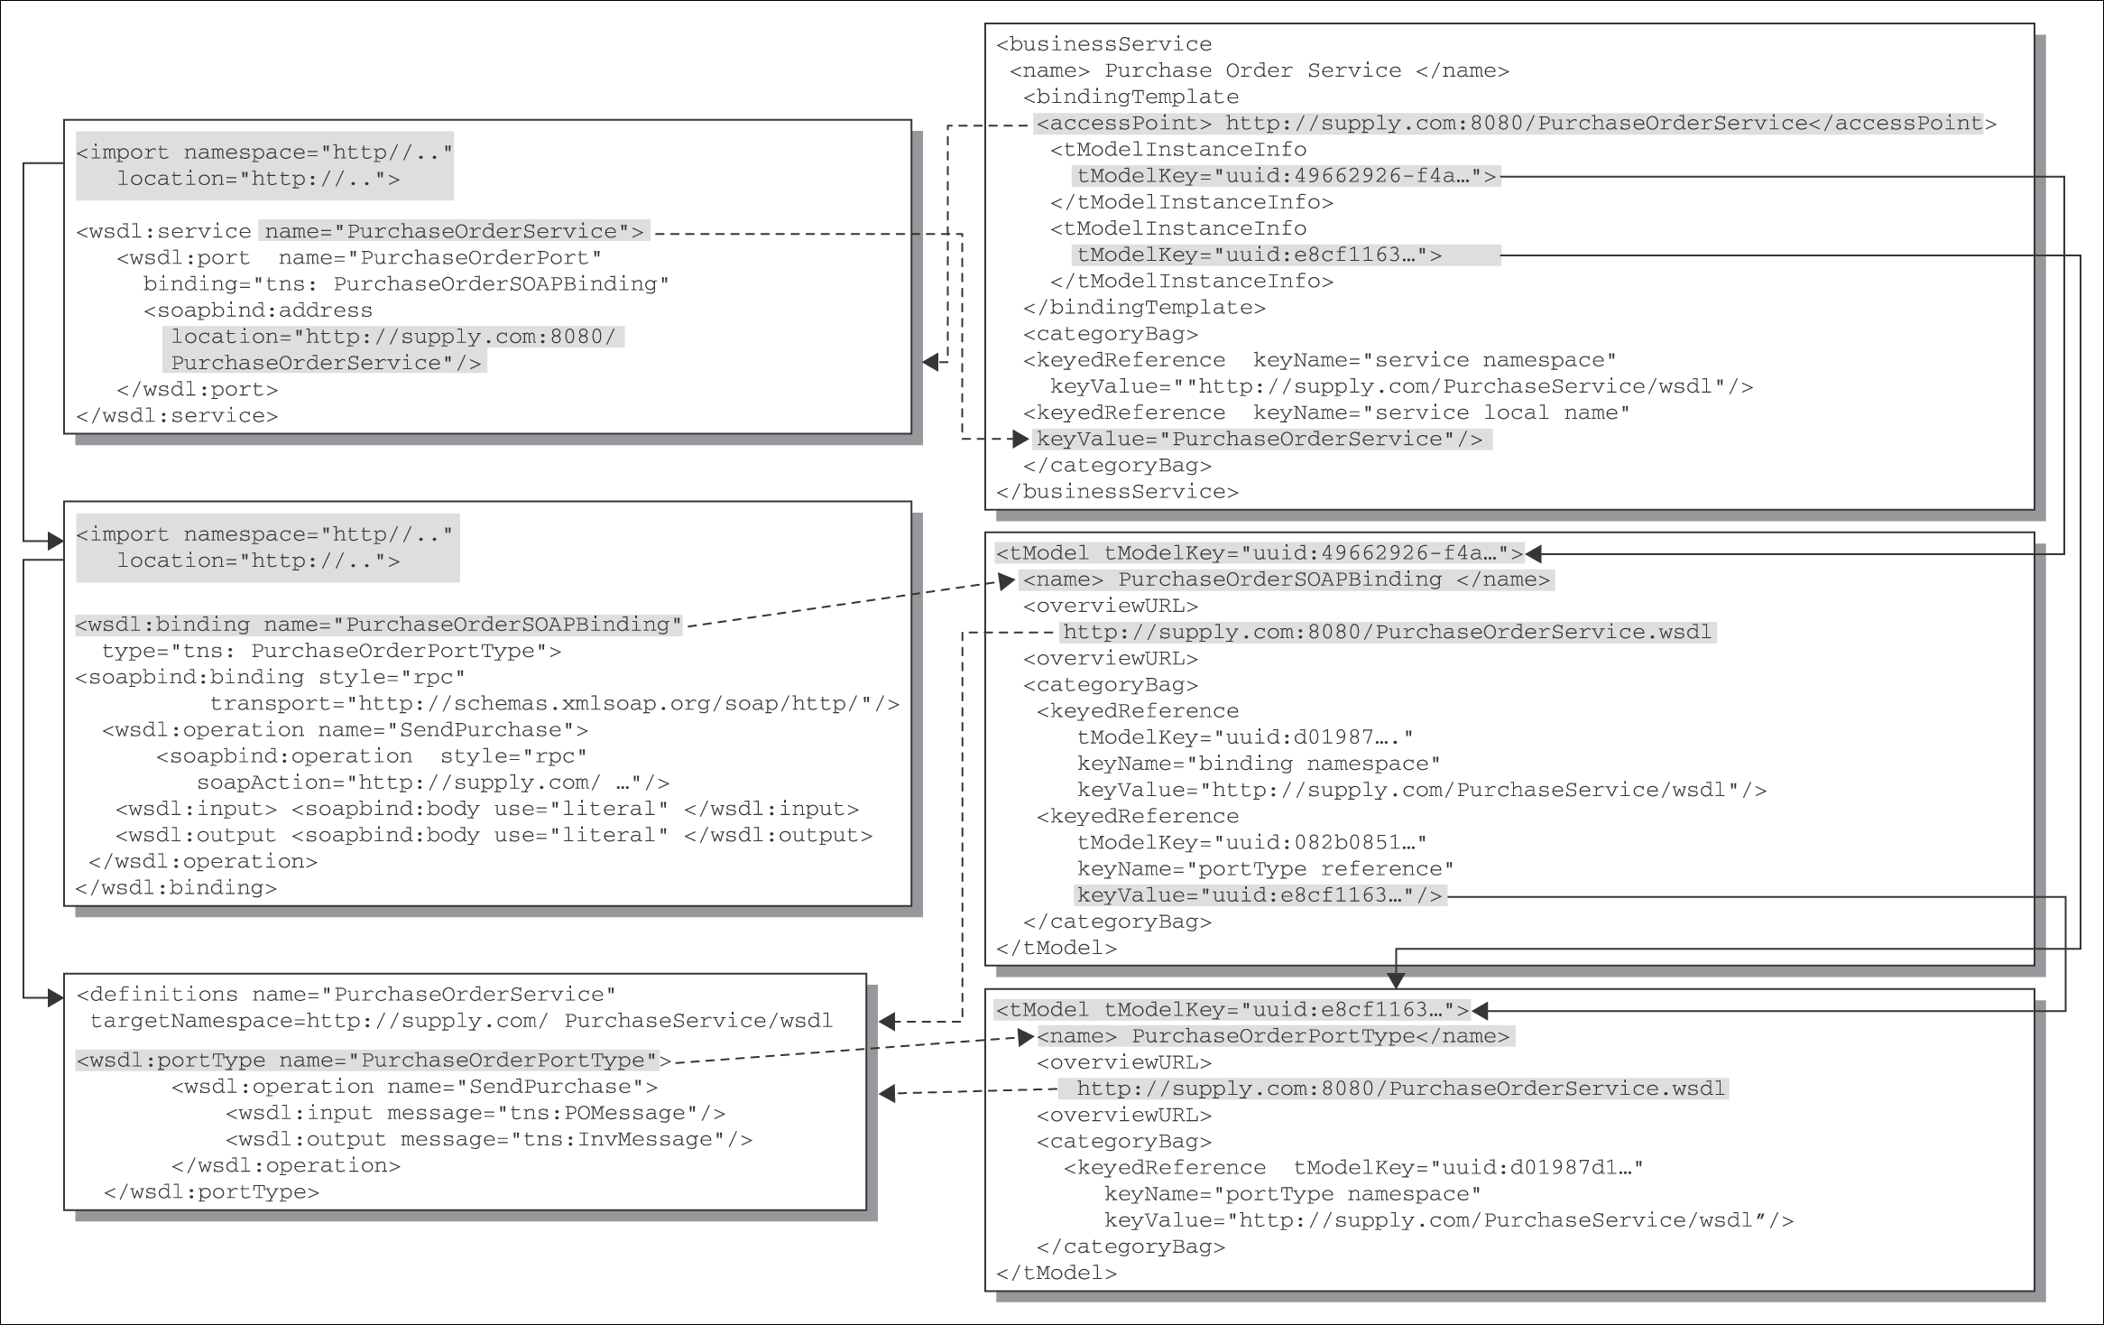
Overview of WSDL to UDDI mapping

Slide 25
Summary of the UDDI data model
BusinessEntity
businessKey, name, contact, description,
identifiers, categories
WSDL document
External web service
interface description
(located at the service
provider)
BusinessService
serviceKey, businessKey, name
description, categories
BindingTemplate
bindingKey, serviceKey,
description, categories,
access point
tModel
name, description,
overview document,
URL pointer to WSDL

Slide 26
Interaction with an UDDI registry
UDDI provides application program interfaces (APIs) for access to a UDDI system:
  UDDI inquiry: to locate and find details about entries in a UDDI registry. Supports a number of patterns (browsing, drill-down).
  UDDI publication: to publish and modify information in a UDDI registry.
  UDDI security: for access control to the UDDI registry (token based).
  UDDI subscription: for clients to subscribe to changes of information in the UDDI registry.
  UDDI replication: to perform replication of information across nodes in a UDDI registry.
  UDDI custody and ownership transfer: to change the owner (publisher) of information.
UDDI also provides a set of APIs for clients of a UDDI system:
  UDDI subscription listener: the client side of the subscription API.
  UDDI value set: used to validate the information provided to a UDDI registry.

Slide 27
UDDI enquiry API
Requestors can obtain information from a UDDI registry using its enquiry interface.
  Enquiries enable trading organizations to find businesses, services, or technical characteristics meeting certain criteria.
Browse functions search the registry based on keywords and return summary lists with overview information (key, name, and description) about matching businesses or services.
Find qualifiers are used to sort the results and to control the keyword matching.
  To minimize the number of requests, find queries can be nested.
Drill-down functions fetch the specific UDDI data structures about particular entries given their key, returned by the Browse functions.
Browse functions
find_business
find_relatedBusinesses
find_service
find_binding
find_tModel
Drill-down functions
get_businessDetail
get_operationalInfo
get_serviceDetail
get_bindingDetail
get_tModelDetail
UDDI Version 3.0 Specification, 19 July 2002

Slide 28
UDDI publishing and security API
The publishing interface can be used by clients to store and update information contained in a UDDI registry.
The registry performs access control for all publishing functions: information about the entries can only be edited by the owner.
Category information and keyed references associated with the entries are validated before accepting new information into the registry.
Save operations allow a client to add or update information in the UDDI.
  Each of the primary UDDI data structures has a corresponding save operation.
  Deletion functions are used to remove entries identified by their key from the registry. Removing a business will remove all services associated with it.
The same publishing functions are used both to add new information or replace existing information, depending on whether a valid key is passed or not.
Security session management functions
get_authToken, discard_authToken
Publishing functions Deletion functions
save_business delete_business
save_service delete_service
save_binding delete_binding
save_tModel delete_tModel

Slide 29
Querying the UDDI
<find_business generic="2.0" xmlns="urn:uddi-org:api_v2">
<name xml: lang="en"> Automotive Equipment Manufacturing Inc. </name>
<name xml: lang="en"> Manufacturing Goods Co. </name>
</find_business>
Query 1 Finding business entities by name.
<find_business generic="2.0" xmlns="urn:uddi-org:api_v2">
<categoryBag>
<!—North American Industry Classification System (NAICS) -->
<keyedReference
keyName="Automotive parts distribution"
keyValue="…"
tModelKey="…"/>
……
</categoryBag>
</find_business>
<find_tModel generic="2.0" xmlns="urn:uddi-org:api_v2">
<categoryBag>
<keyedReference
tModelKey="uuid:6e090afa…"
keyName="WSDL type"
keyValue="binding" />
<keyedReference
tModelKey="uuid:082b0851… "
keyName="portType reference"
keyValue="uuid:e8cf1…" />
</categoryBag>
</tModel>
Query 2 Finding <businessEntity> entries by category.
<find_tModel generic="2.0" xmlns="urn:uddi-org:api_v2">
<name> PurchaseOrderPortType </name>
<categoryBag>
<keyedReference
tModelKey="uuid:d01987d1…"
keyName="portType namespace"
keyValue="http://supply.com/PurchaseService/wsdl" />
<keyedReference
tModelKey="uuid:6e090afa…"
keyName="WSDL type"
keyValue="portType" />
</categoryBag>
</tModel>
Query 4 Find all <binding tModel> for PurchaseOrderPortType.
Query 3 Finding the <tModel> for <portType> name.

Slide 30
Business information provider roles
Registry operators: organizations (operator nodes) that host and operate the UDDI business registry (UBR).
  These manage and maintain the directory information, cater for replication of business info. and other directory-related functions.
  The registry works on a “register once, published everywhere” principle.
Standard bodies and industry consortia: these publish descriptions in the form of service type definitions (<tModel>s).
  These <tModel>s do not contain the actual service definitions, instead they have a URL that points to the location where the service descriptions (usually in WSDL) are stored.
Service providers: commonly implement Web services conforming to service type definitions supported by UDDI.
  They publish information about their business and services in the UDDI.
  The published data also contains the end point of Web services.

Slide 31
UDDI deployment possibilities
e-marketplace UDDI: an e-marketplace, a standards body, or a consortium of organizations that participate and compete in the industry can host this private UDDI node.
  The e-marketplace could run a local version of a UDDI registry with its data shielded from the global UDDI registry.
  The entries in this private UDDI relate to a particular industry or narrow range of related industries.
Business partner UDDI registry: a private UDDI node hosted behind one of the business partner’s firewall and only trusted or vetted partners can access the registry.
  It also contains Web service description meta-data published by trusted business parties (organizations with which the hosting organization has formal agreements/relationships).
Portal UDDI: this type of deployment is on an enterprise’s firewall and is a private UDDI node that contains only meta-data related to the enterprise’s Web services.
  External users are allowed to invoke find operations on the registry; however, a publish operation would be restricted to services internal to the portal.
  It gives a company ultimate control over how the meta-data describing its Web services is used.
Internal UDDI: this allows applications in different departments of the organization to publish and find services, and is useful for large organizations.
  The major distinction of this UDDI variant is the potential for a common administrative domain that can dictate standards (for example a fixed set of <tModels> can be used).
  This type of UDDI deployments is called EAI UDDI, as it allows corporations to deploy and advertise Intranet Web services.

